Slide 1


HANDS ON SESSION MANIPULATING DATASETS
A GUIDED TOUR OF AI:
FROM FOUNDATIONS
TO LATEST APPLICATION

Slide 2
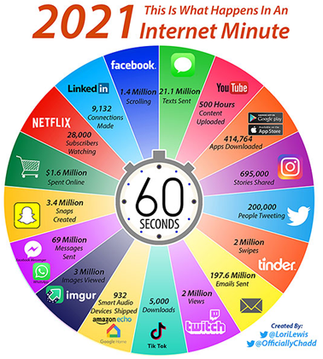
The World is Data Rich

Slide 3
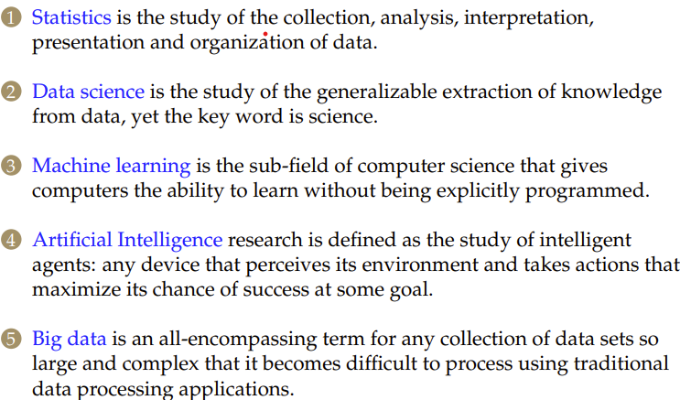

Recent Buzz Words

Slide 4
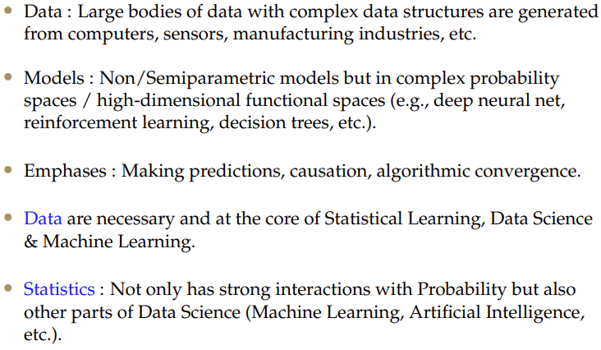
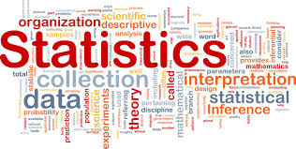
Statistics

Slide 5
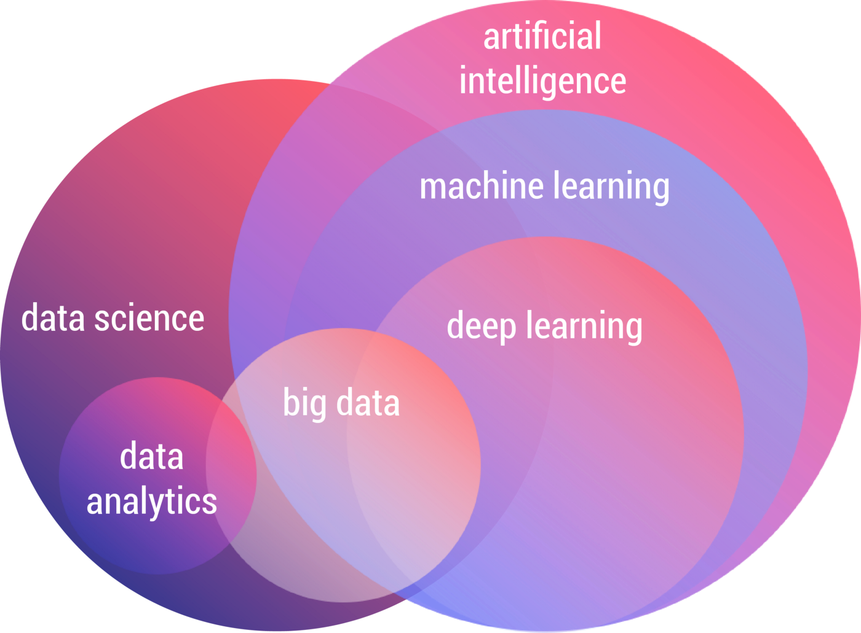
Data Science
“Data is the new oil. It’s valuable, but if unrefined it cannot really be used. It has to be changed into gas, plastic, chemicals, etc to create a valuable entity that drives profitable activity; so must data be broken down, analyzed for it to have value.”
- Clive Humby, UK Mathematician and Architect of Tesco’s Clubcard.

Slide 6
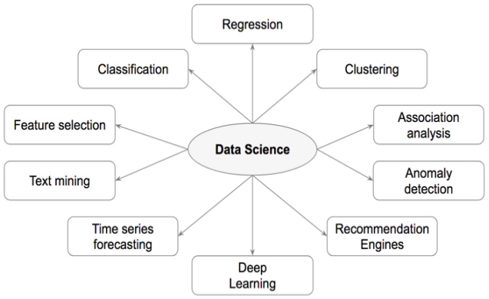
"When you’re fundraising, it’s AI.
When you’re hiring, it’s ML.
When you’re implementing, it’s Linear Regression.
When you’re debugging, it’s printf()."
- Baron Schwartz, Founder and CEO of VividCortex, 2017.

Slide 7
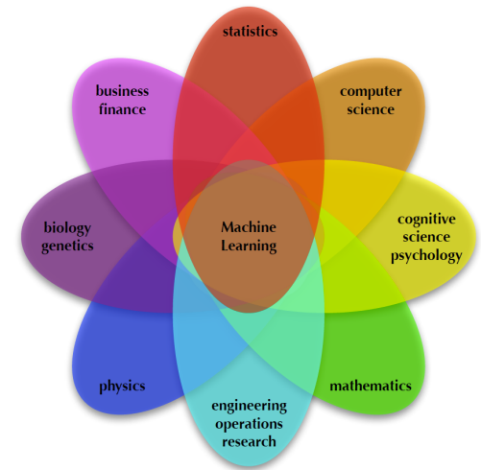
Machine Learning
Machine learning is the field of study that gives computers the ability to learn without being explicitly programmed.

Slide 8
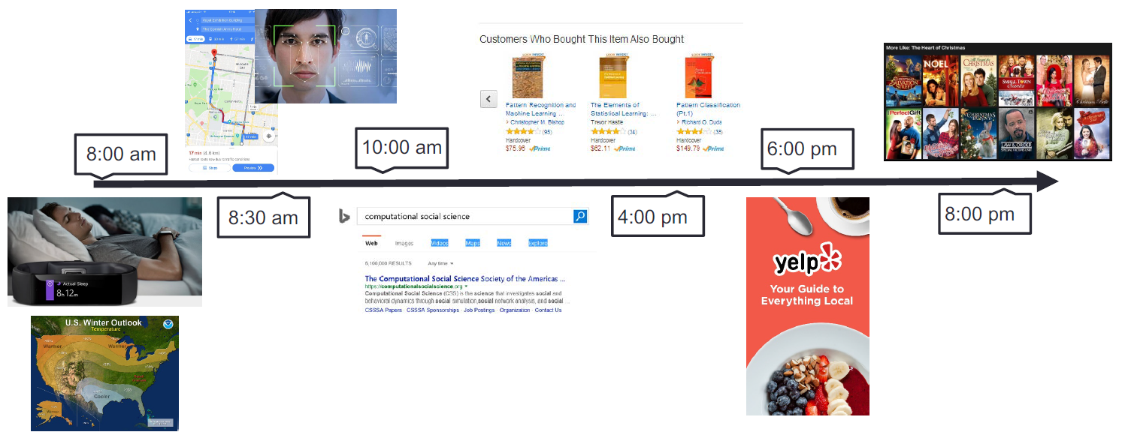
Machine Learning is impacting our life

Slide 9
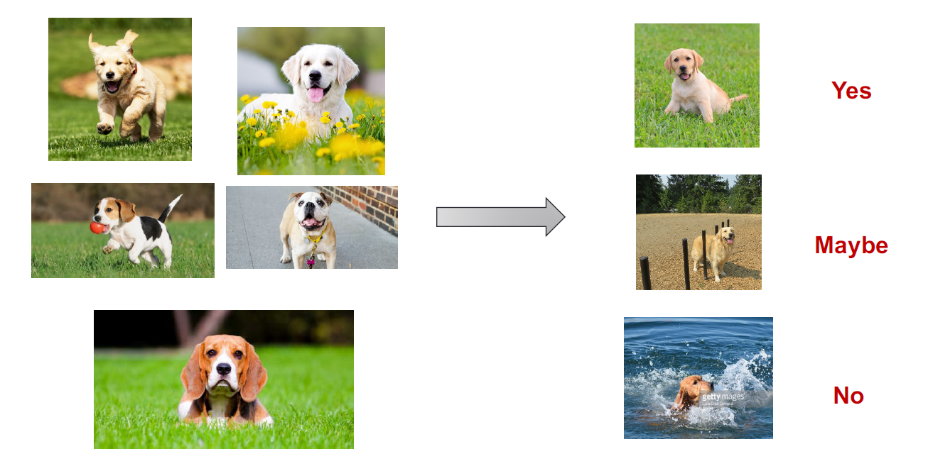
What Machine Learning can do?

Slide 10
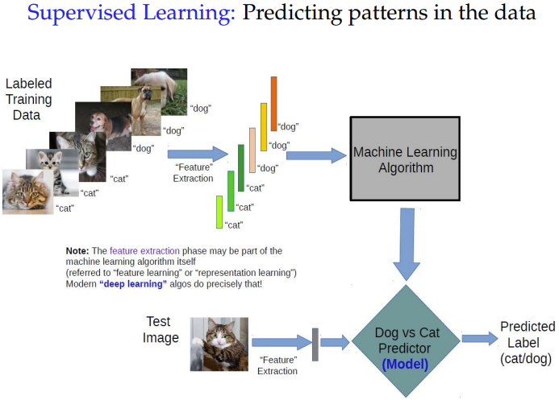
Supervised Learning Workflow

Slide 11
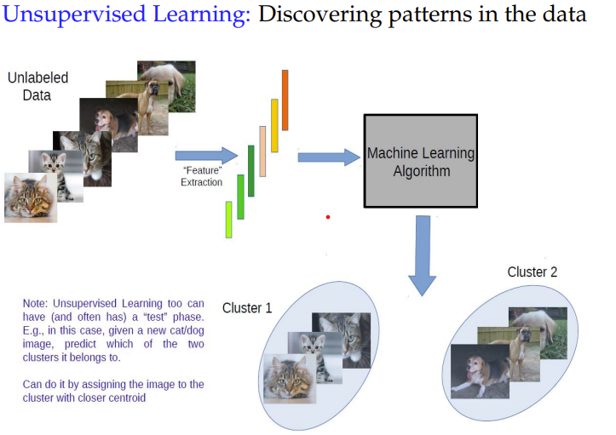
Unsupervised Learning Workflow

Slide 12
Data Summarization
To identify the typical characteristics of data (i.e., to have an overall picture).
To identify which data should be treated as noise or outliers.
The data summarization techniques can be classified into two broad categories:
Measures of location
Measures of dispersion

Slide 13
Measurement of location
It is also alternatively called as measuring the central tendency.
A function of the sample values that summarizes the location information into a single number is known as a measure of location.
The most popular measures of location are
Mean
Median
Mode
Quartile

Slide 14
Measures of dispersion
Location measure are far too insufficient to understand data.
Another set of commonly used summary statistics for continuous data are those that measure the dispersion.
A dispersion measures the extent of spread of observations in a sample.
Some important measure of dispersion are:
Range
Variance and Standard Deviation
Mean Absolute Deviation (MAD)
Absolute Average Deviation (AAD)
Interquartile Range (IQR)

Slide 15
Graphical Representation of Data
Visualization techniques are ways of creating and manipulating graphical representations of data.
We use these representations in order to gain better insight and understanding of the problem we are studying - pictures can convey an overall message much better than a list of numbers.
Data
numerical categorical
(or quantitative) (or qualitative)
Line or Dot plots Bar Charts
Histogram Pie Charts

Slide 16
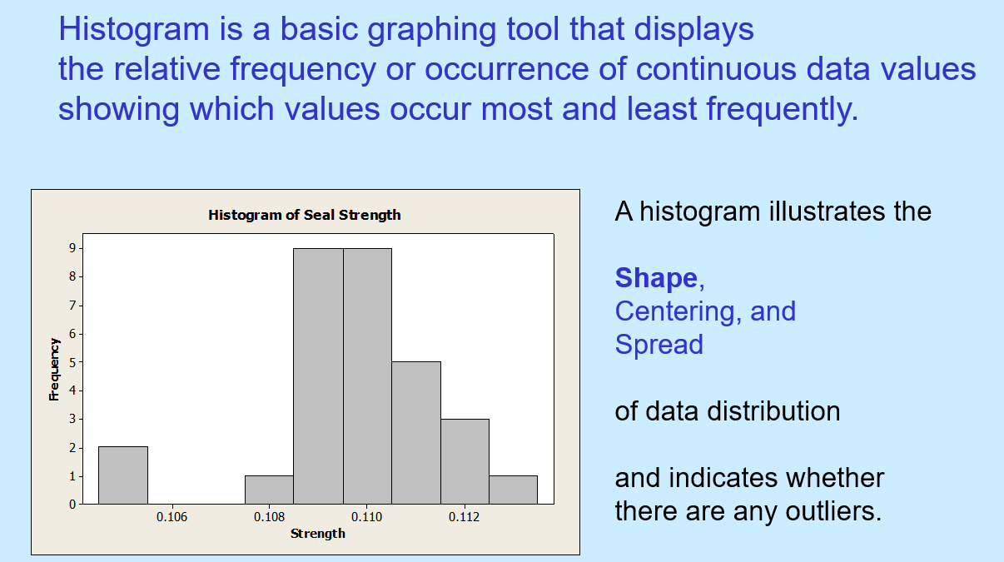
Histogram

Slide 17
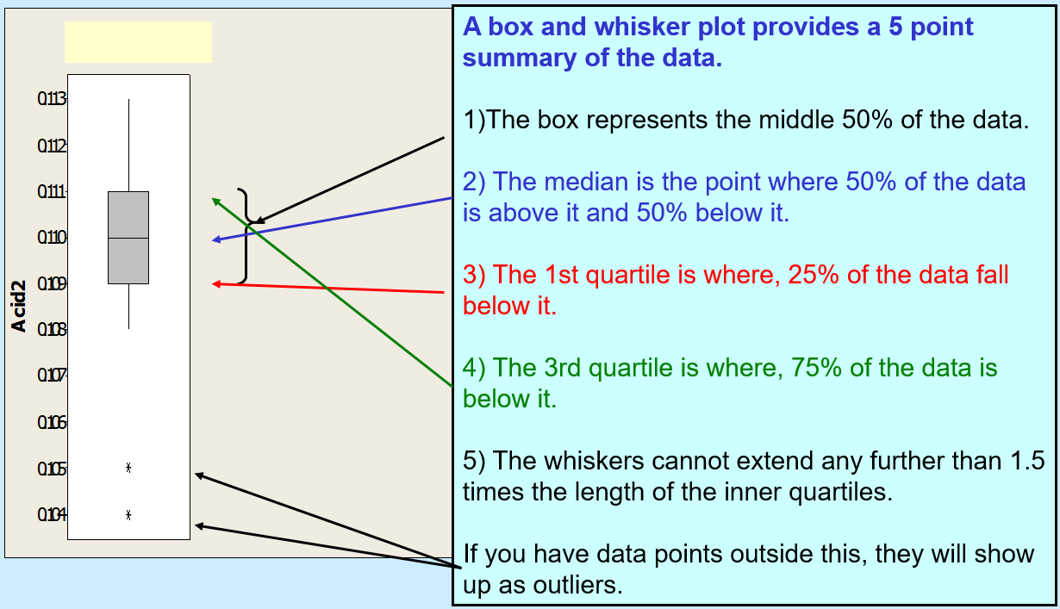
Box Plot

Slide 18
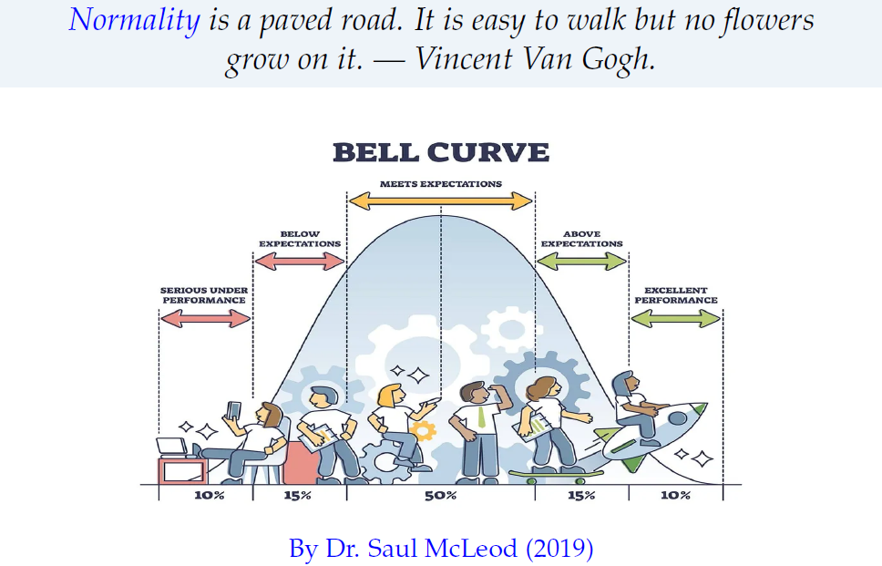
Normality and Statistics

Slide 19
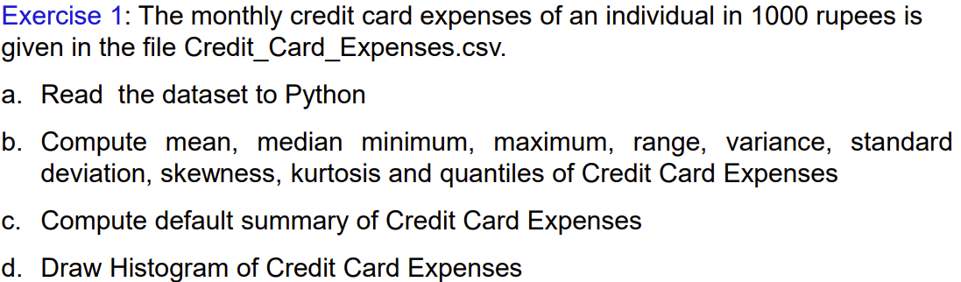
Lets try some exercise in Python

Slide 20
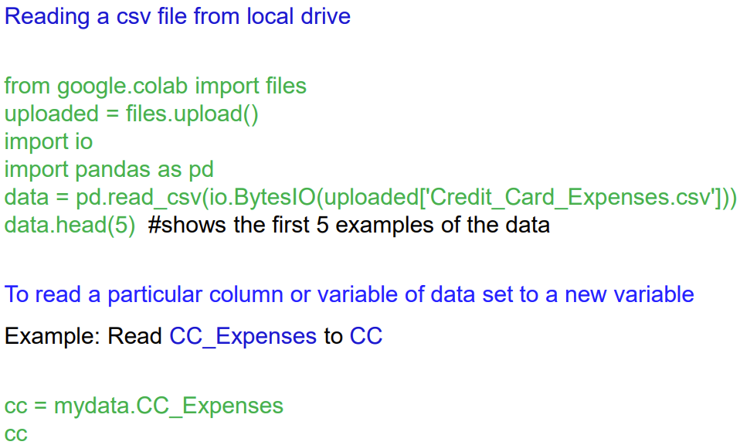
Descriptive Statistics Using Python

Slide 21
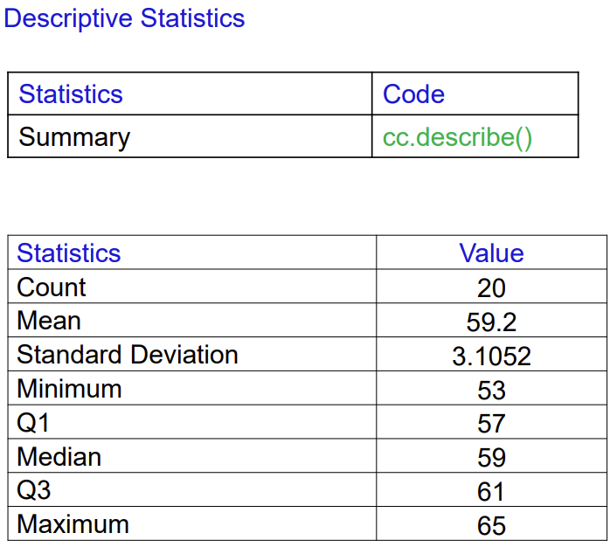
Descriptive Statistics Using Python

Slide 22
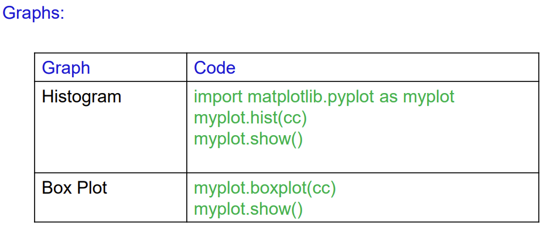
Descriptive Statistics Using Python

Slide 23
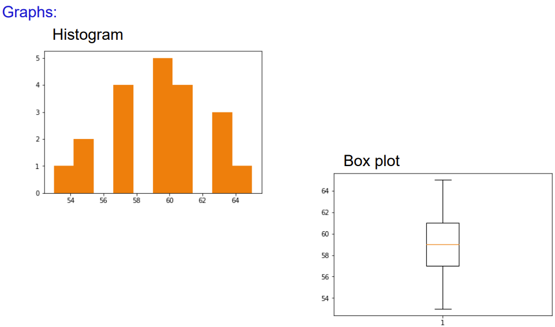

Slide 24
Correlation Analysis
In statistics, the word correlation is used to denote some form of association between two variables.
Example: Weight is correlated with height?
The correlation may be positive, negative or zero.
Positive correlation: If the value of the attribute A increases with the increase in the value of the attribute B and vice-versa.
Negative correlation: If the value of the attribute A decreases with the increase in the value of the attribute B and vice-versa.
Zero correlation: When the values of attribute A varies at random with B and vice-versa.

Slide 25
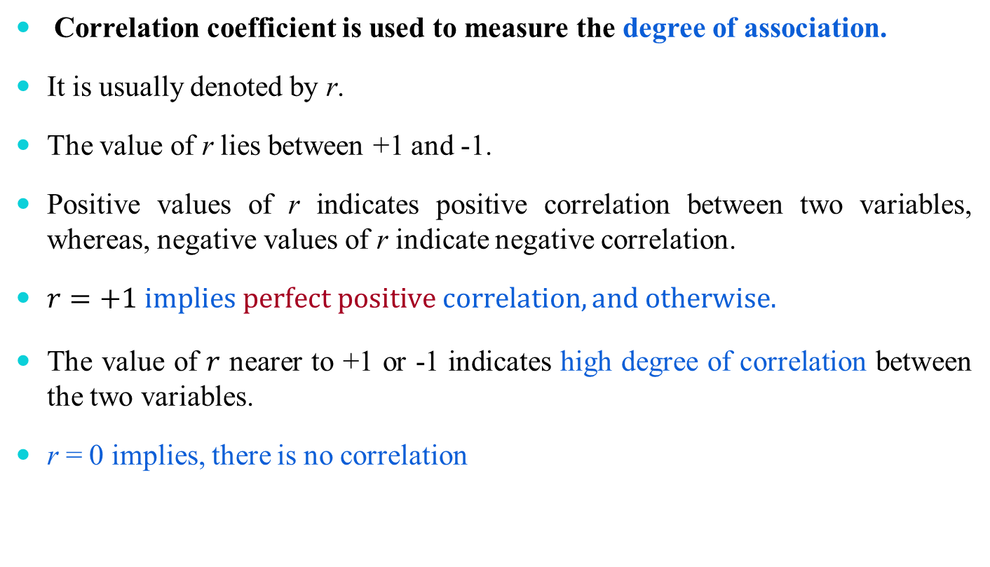
Correlation Coefficient

Slide 26
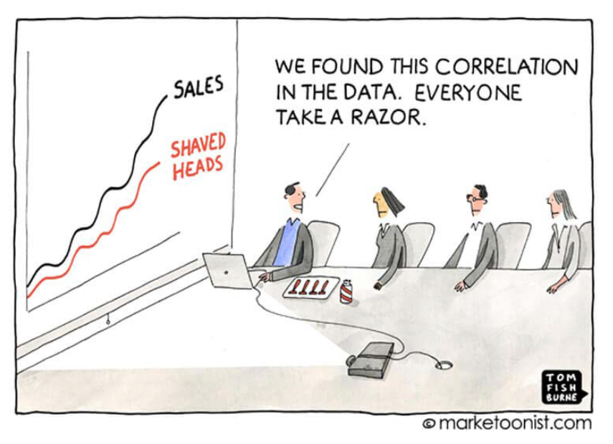
A plausible reason: Correlation
Correlation is the basics of Machine Learning

Slide 27
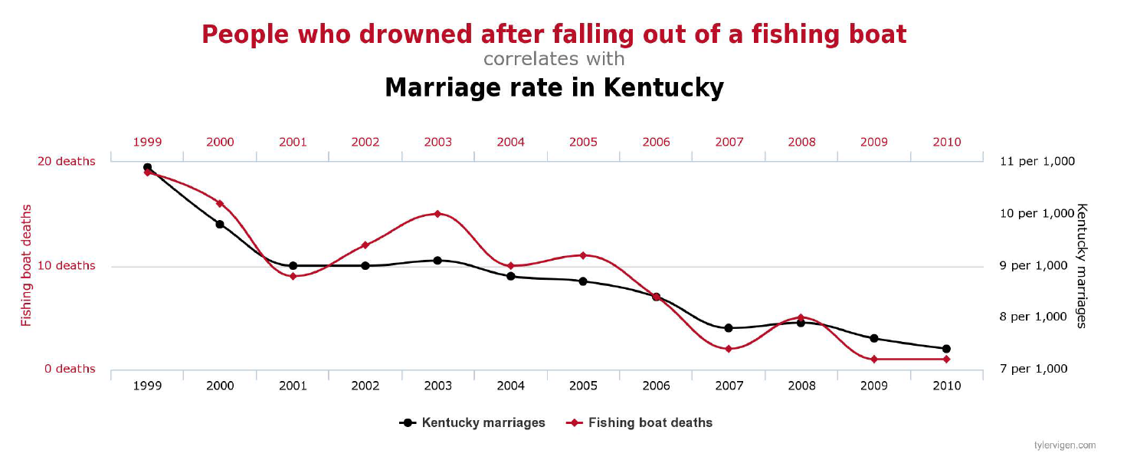
Correlation does not imply causation

Slide 28
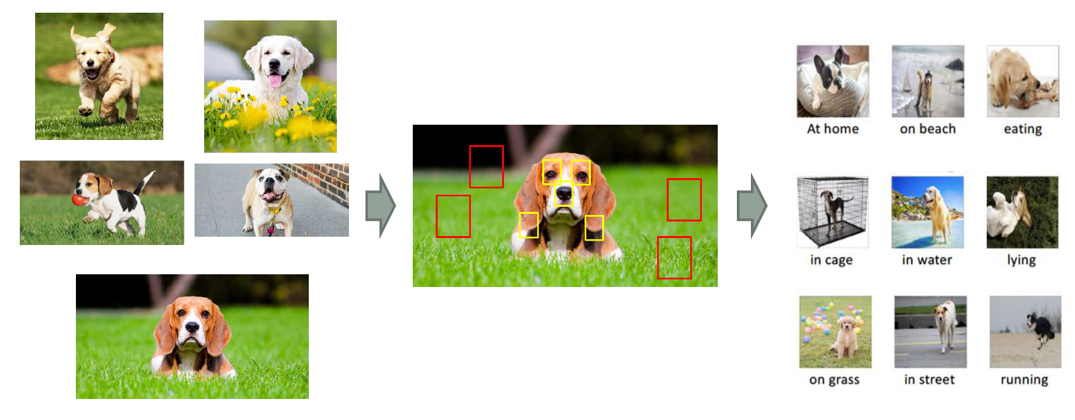
Correlation is unstable

Slide 29
Data
Let us assume that we have a random sample of size n on two variables namely x and y. The sampled values are {(x₁,y₁), (x₂,y₂), …, (x_{n},y_{n})}.
It is necessary to have ordered pairs if we want to find relations between x and y; i.e., each observation consists of two values – one on x and the other on y, i-th observation being (x_{i},y_{i}), i = 1,2, …, n.
It may sometime be necessary to assume that the sample observations are coming from continuous distribution.

Slide 30
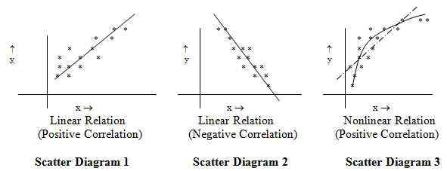
Scatter or dot diagram
The first step to get an idea about whether there exists any relation between x and y and if exists, the degree of relation, is to draw scatter or dot diagram.
The scatter diagram is nothing but the set of n points of (x,y) pairs shown on a graph paper. The following are some examples of scatter diagrams:
.

Slide 31
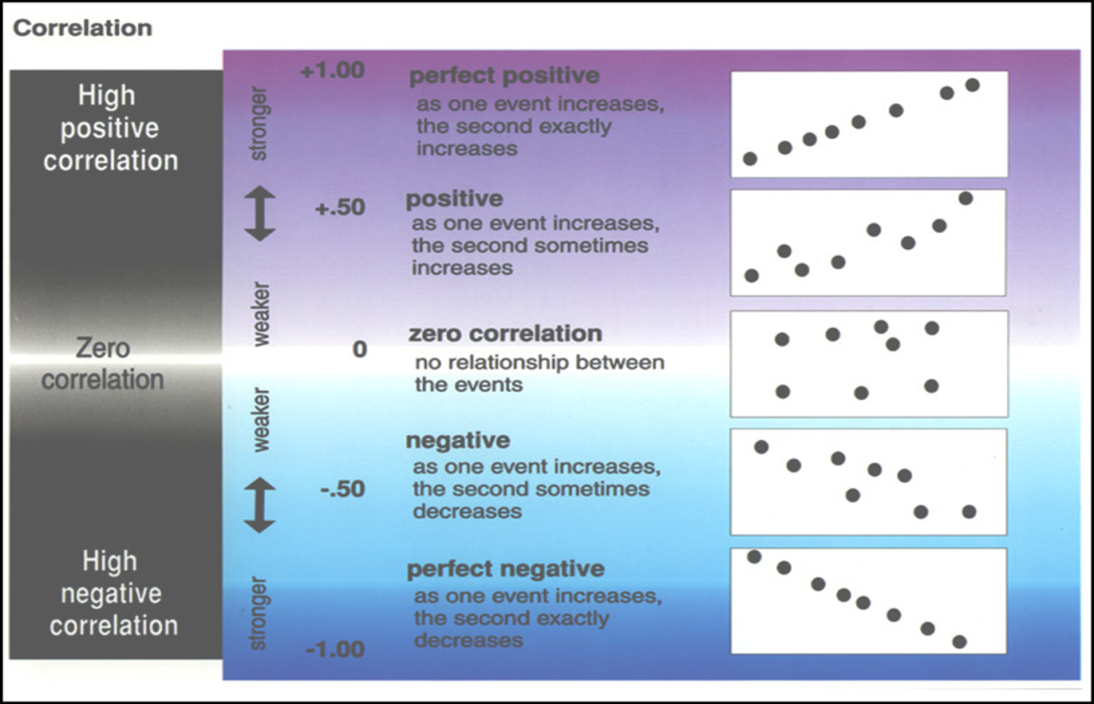
Remarks from Scatter Plots & Correlation Coefficient

Slide 32
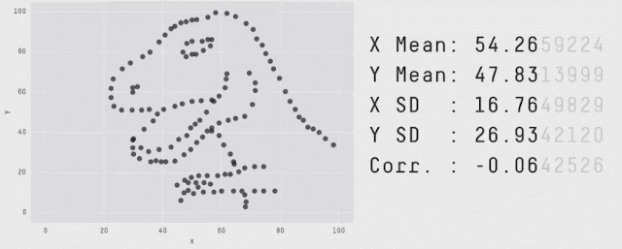
What stories can scatter plot tell?
In 1973, a famous statistician, Francis Anscombe, demonstrated how important it is to visualize the data. The concept got extended later to create Datasaurus Dozen.
It is a collection of 12 scatterplots with the same means, standard deviations, and correlation coefficient for X and Y (up to 2 decimal places).
However, the shape of the data is very different from each other. Therefore, the scatterplots tell very different stories about the behavior and interrelationships of X and Y.
Data available at https://cran.r-project.org/web/packages/datasauRus/vignettes/Datasaurus.html

Slide 33
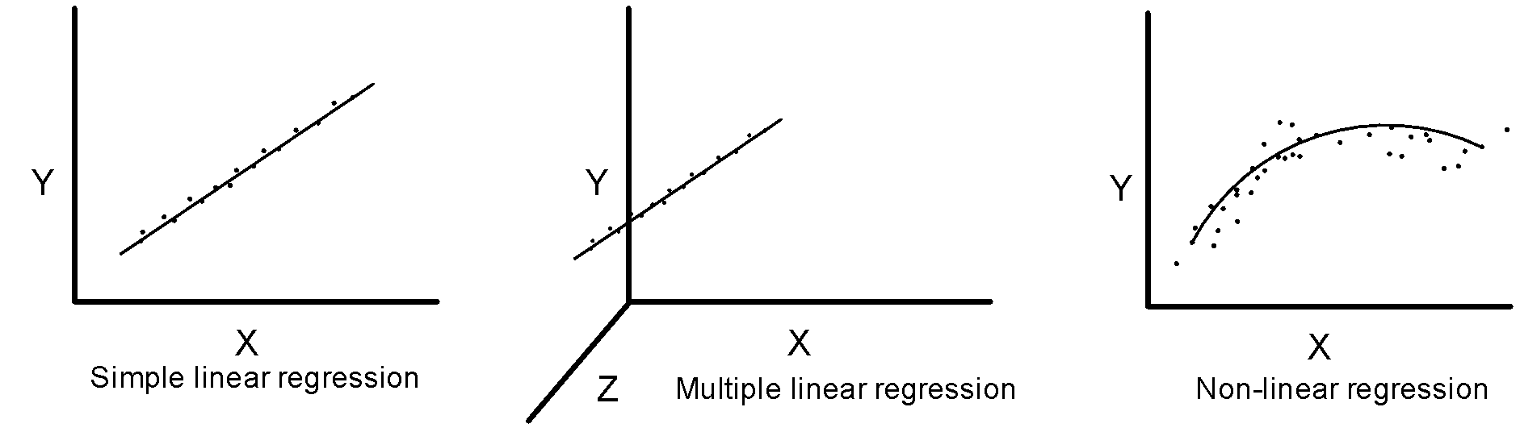
Regression Analysis
The regression analysis is a statistical method to deal with the formulation of mathematical model depicting relationship amongst variables, which can be used for the purpose of prediction of the values of dependent variable, given the values of independent variables.
Classification of Regression Analysis Models
Linear regression models
Simple linear regression
Multiple linear regression
Non-linear regression models

Slide 34
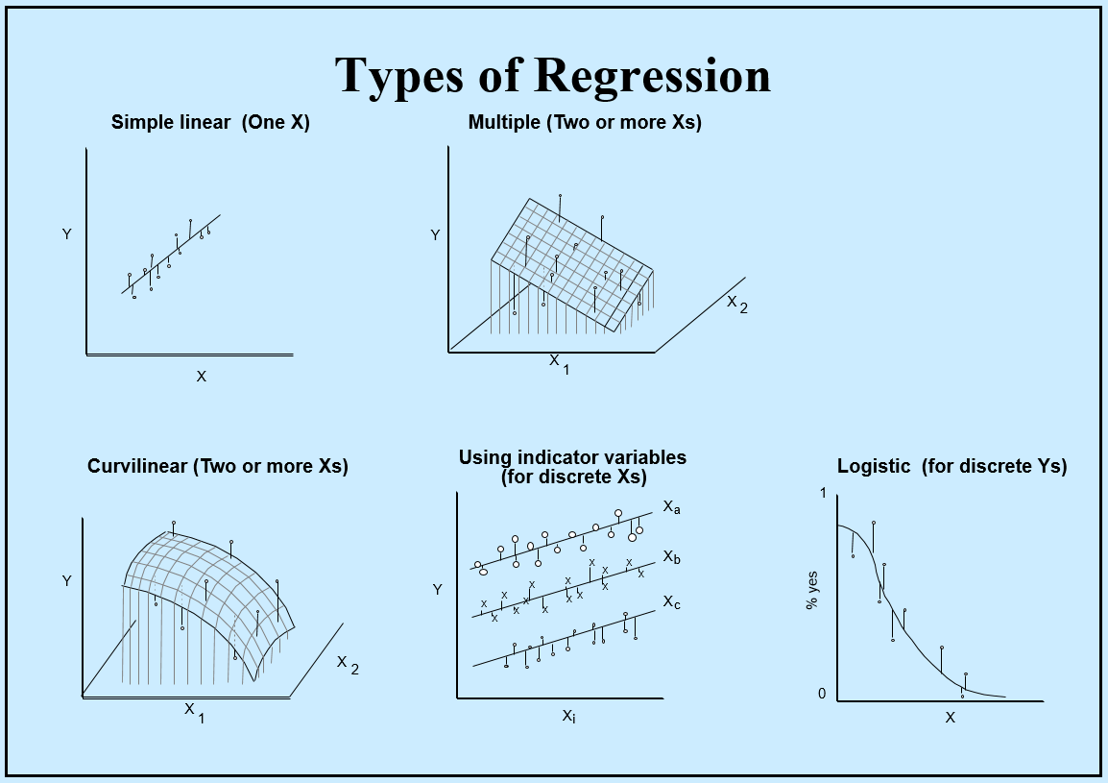
Regression Analysis

Slide 35
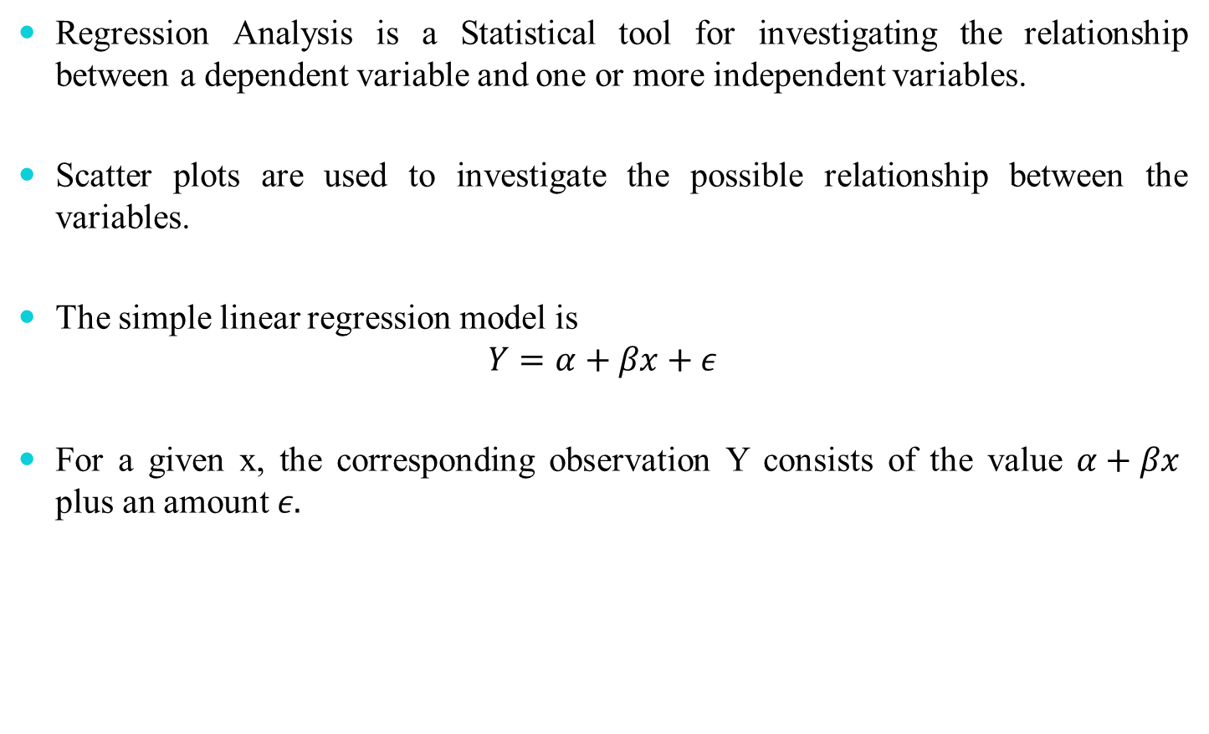
Simple Linear Regression

Slide 36
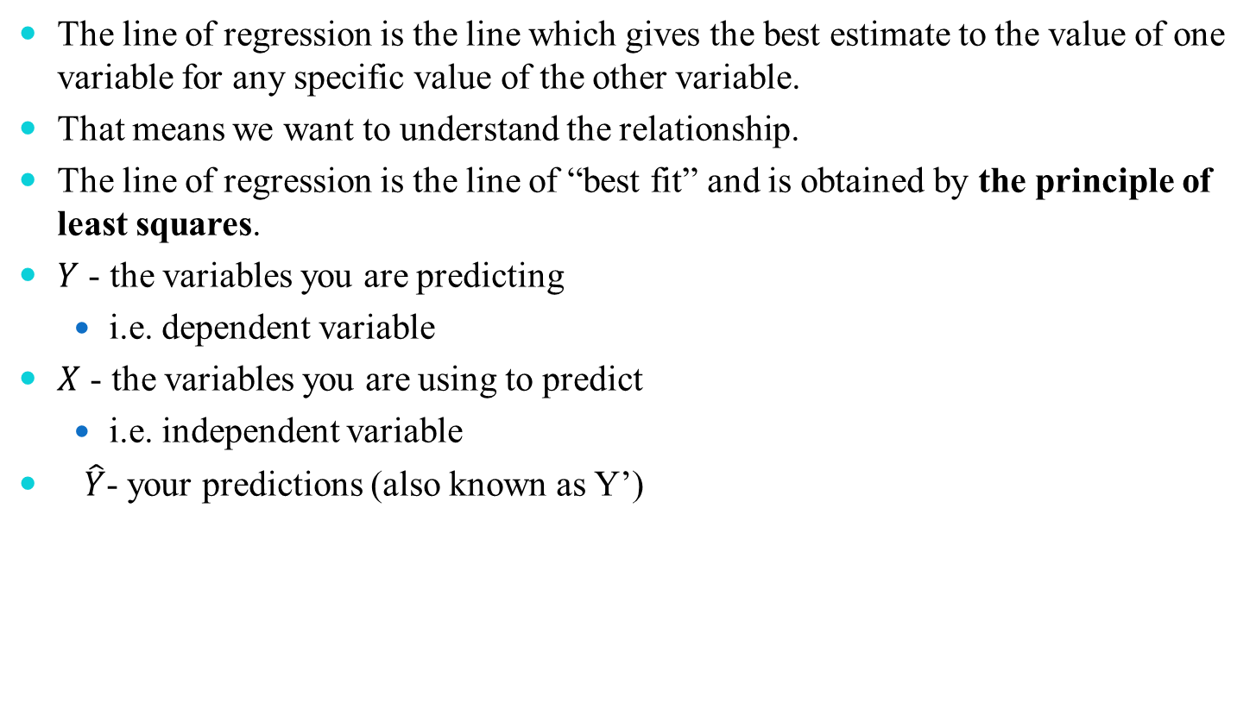
Linear Regression

Slide 37
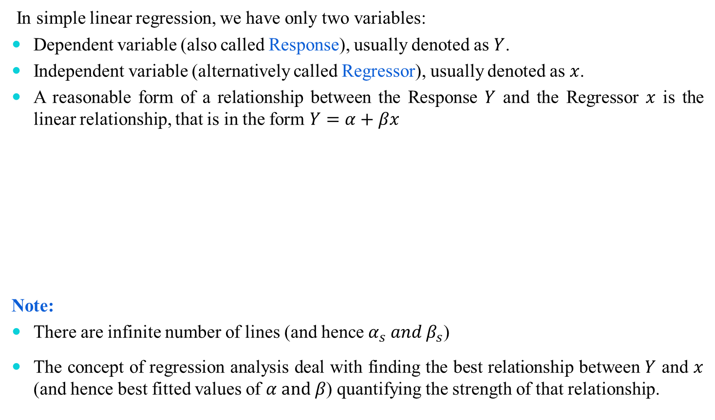
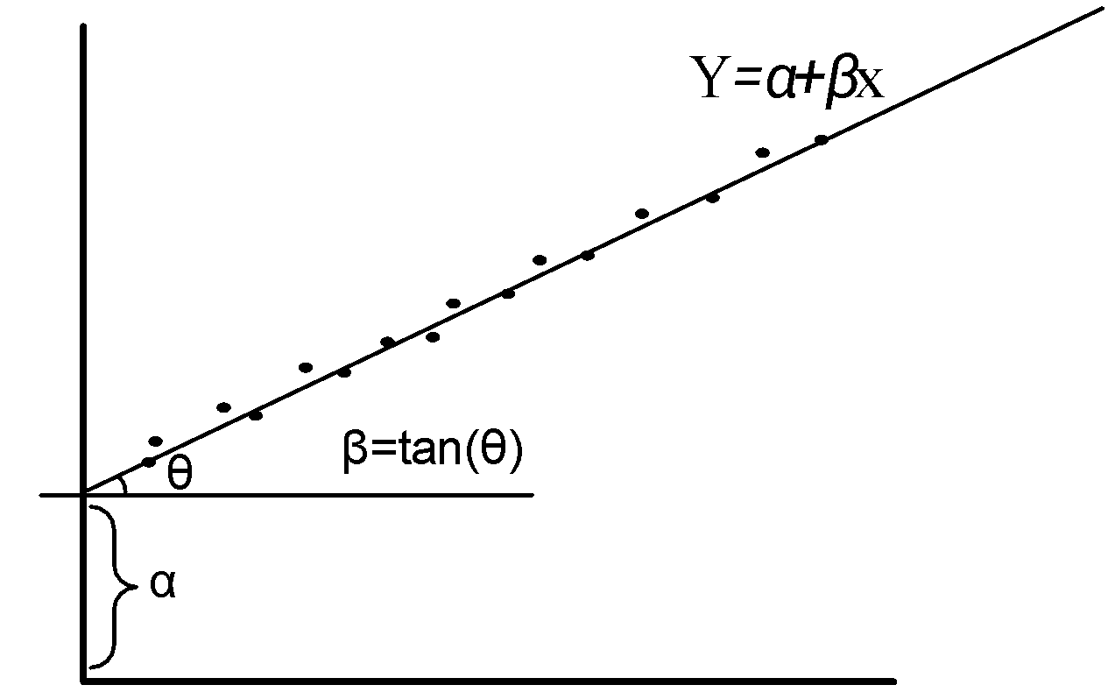
Simple Linear Regression Model

Slide 38
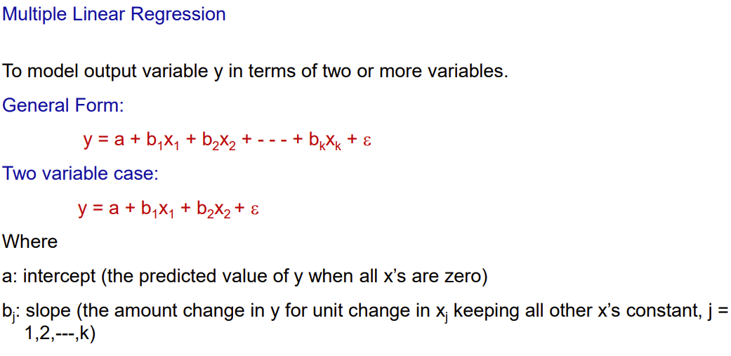

Slide 39
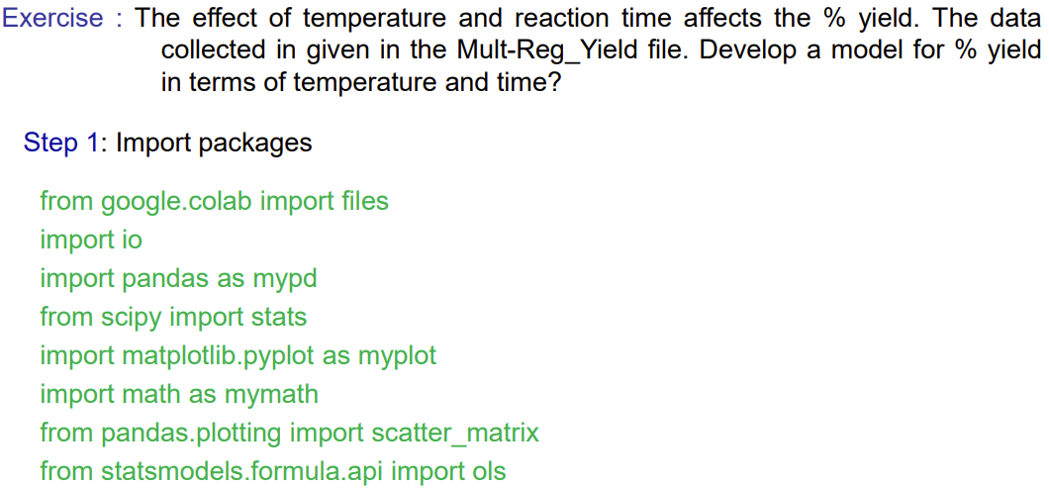
Lets try out in Python

Slide 40
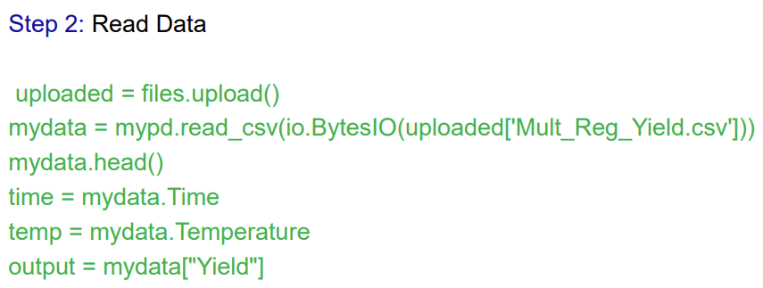
Lets try out Multiple Linear Regression in Python

Slide 41
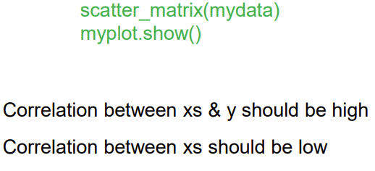
Visualizing the correlation

Slide 42
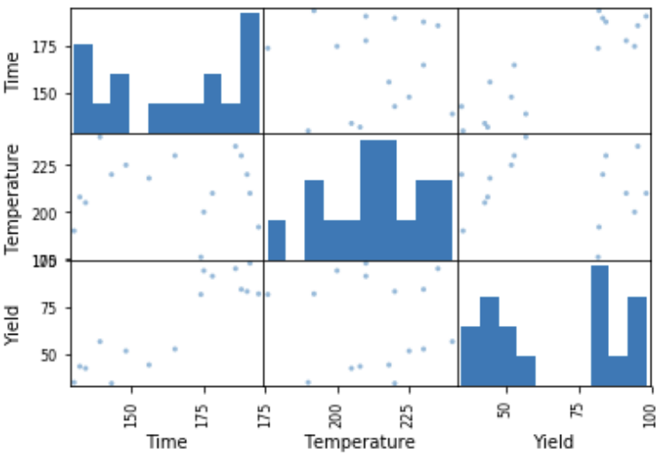
That’s the Plot

Slide 43
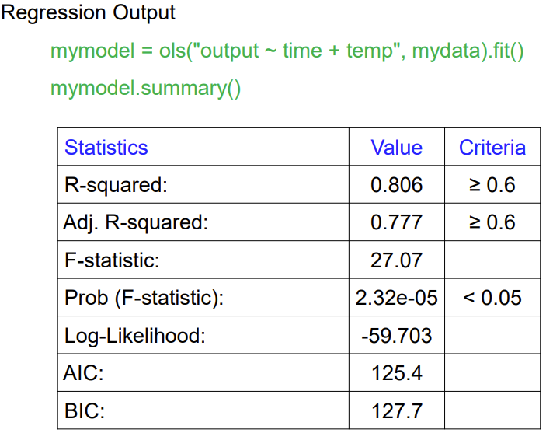
Regression Model

Slide 44
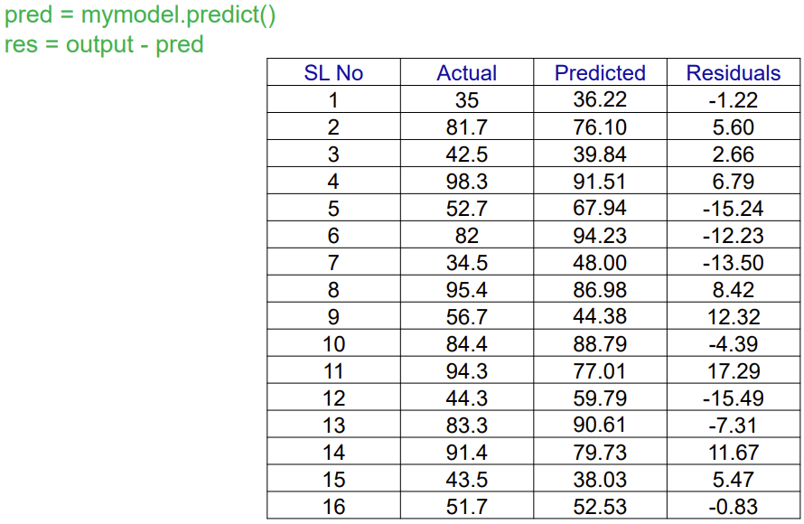
Checking the Residuals

Slide 45
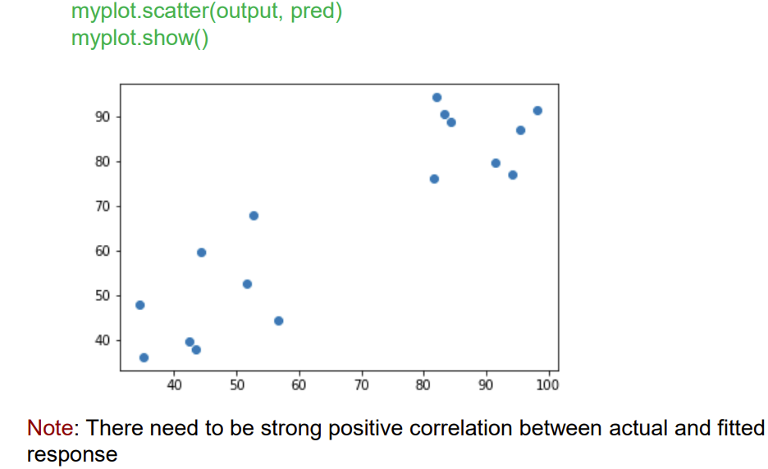
Checking the Residuals

Slide 46
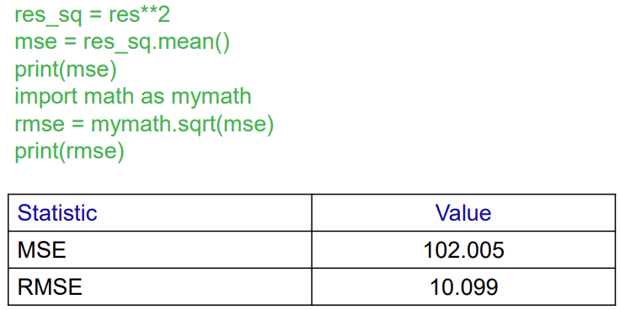
Aggregating the Residuals

Slide 47

Scikit Learn
Extensions to SciPy (Scientific Python) are called SciKits. Scikit-Learn provides machine learning algorithm.
Algorithms for supervised and unsupervised learning
Built on SciPy and Numpy
Standard Python API interface
Open Source
Focused package for data modeling
Probably the best general ML framework out there

Slide 48

Where did Scikit Learn came from?
Joined by Matthieu Brucher as a part of his thesis work
Started by David Cournapeau as a Google summer of code project in 2007
2010
Jan 2010
May 2022
First public release (v0.1 beta)
Latest public release (v1.1 )
funded the project

Slide 49
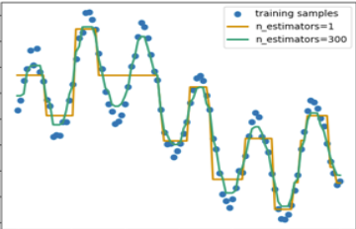
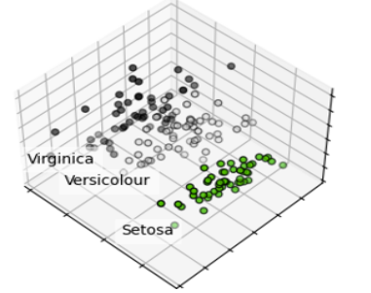
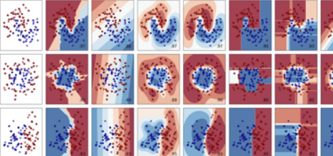
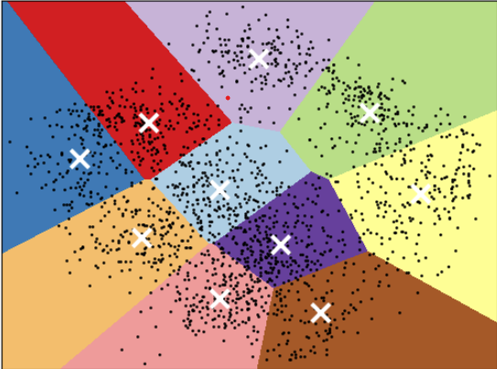
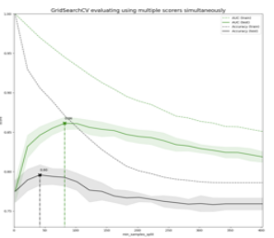
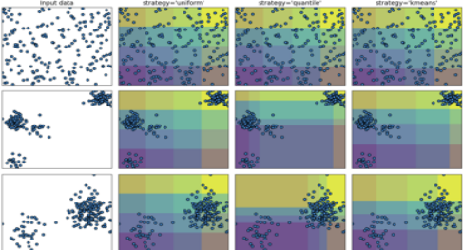
What we can do with Scikit Learn?
Regression
Classification
Dimensionality Reduction
Clustering
Preprocessing
Model Selection

Slide 50

Let’s check out how to use ML in real world datasets

